Slide 1
ALERT organization
Alert who, what, when, where, …

Slide 2
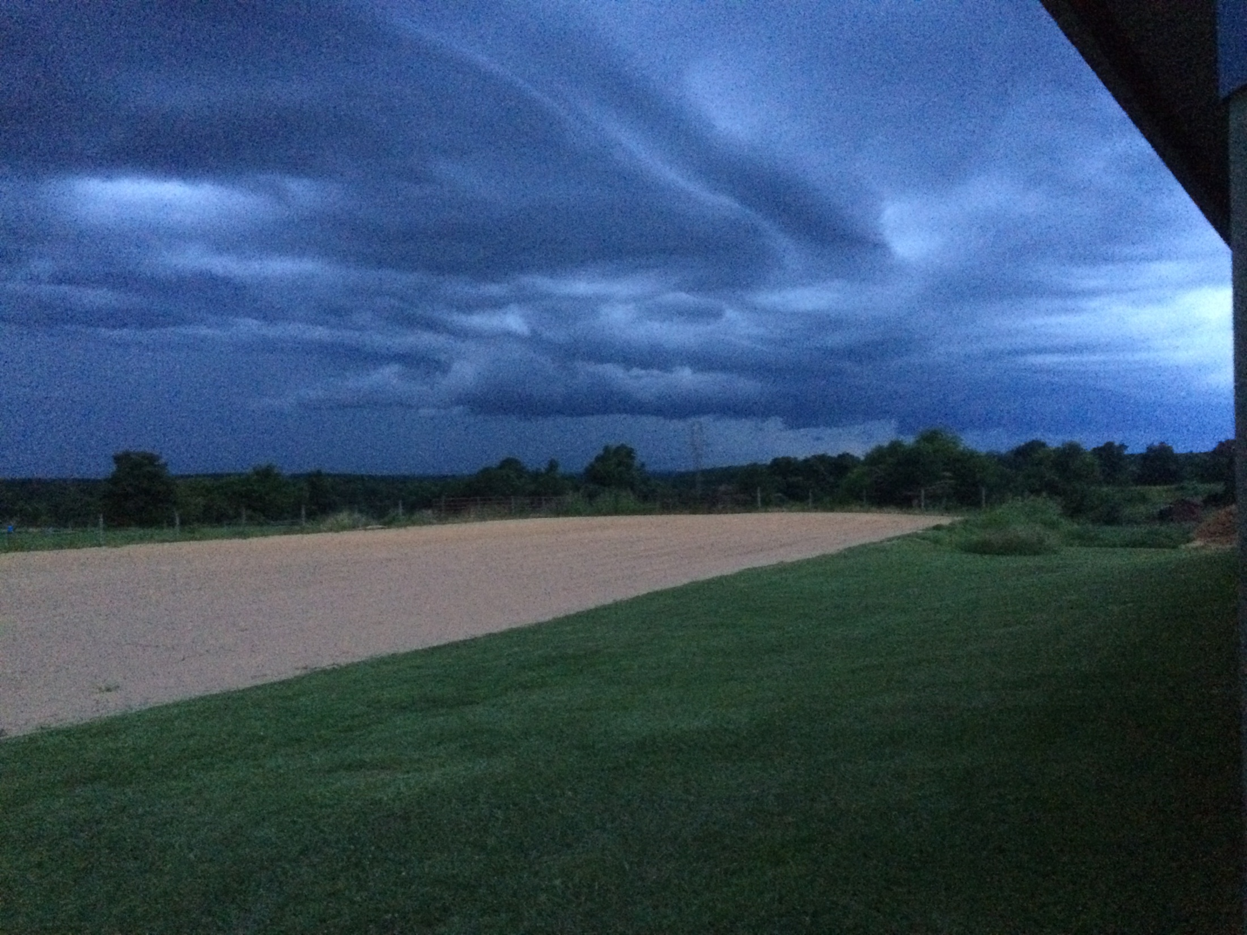

Slide 3
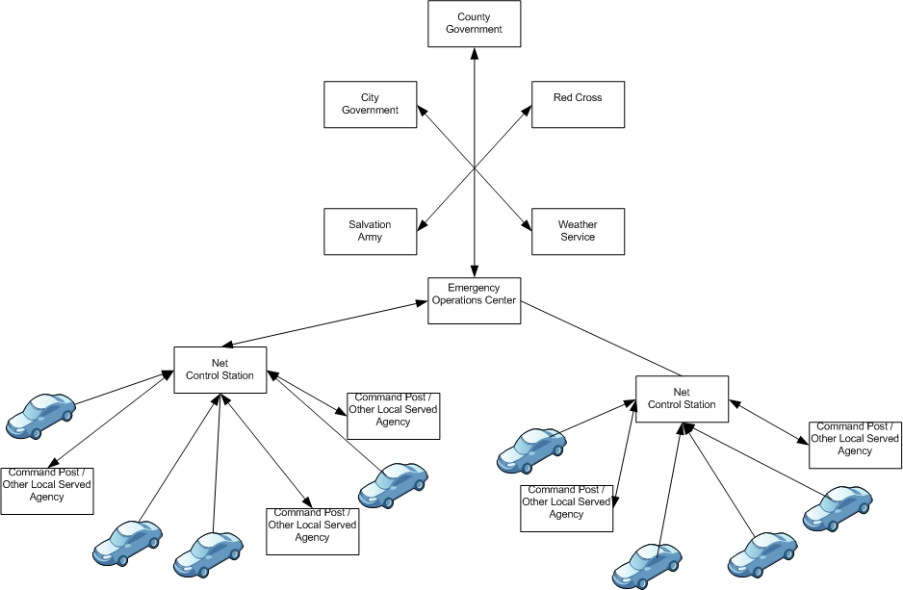
Ham Networks
ALERT

